Slide 1
L7 Logistic Regression

Slide 2
Regression Vs. Classification Problems
Variables can be characterized as either quantitative or qualitative (also known as categorical).
Quantitative variables take on numerical values.
Ex: person’s age, height, or income, the value of a house, and the price of a stock.
Qualitative variables take on values in one of K different classes, or categories.
Ex: the brand of product purchased (brand A, B, or C), whether a person defaults on a debt (yes or no), or a disease diagnosis.
We tend to refer to problems with a quantitative response as regression problems, while those involving a qualitative response are referred to as classification problems

Slide 3
Logistic Regression
If the answer desired is of Boolean form, 0/1 or yes/no, then use Logistic Regression.
Ex: to determine if the given picture is a human or not, we need a yes/no answer
Logistic Regression provides a 0 or 1 prediction, rather than a real value for a continuous variable.
To that extent, it is a classification technique and not a regression problem
Since interest is in predicting a Boolean answer, we need to choose a function which operates within the range 0 to 1.

Slide 4
Logistic Regression
Logistic regression is named for the function used at the core of the method, the logistic function.
The logistic function, also called the sigmoid function
It's an S-shaped curve that can take any real-valued number and map it into a value between 0 and 1, but never exactly at those limits.

Slide 5



Logistic Regression
The first thing to note is that logistic regression is not a regression, but a classification learning algorithm
The name comes from statistics and is due to the fact that the mathematical formulation of logistic regression is similar to that of linear regression
standard logistic function (also known as the sigmoid function) is:
e is the base of the natural logarithm also called Euler’s number(e≈2.718)
e^{x} is also known as the exp(x) function in programming languages referred as “exponential of x”
value is the actual numerical value that we want to transform.
Note: The natural logarithm (ln) and the exponential function e^{x} are inverse operations
Next: Plot of the numbers between -5 and 5 transformed into the range 0 and 1 using the logistic function

Slide 6
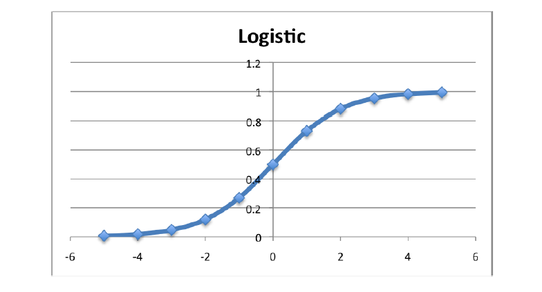
Standard logistic function - Graph
Plot of the numbers between -5 and 5
Transformed into the range 0 and 1 using the logistic function
By looking at the graph of the standard logistic function, we can see how well it fits our classification purpose:
we could interpret the output of f(x)
if it’s higher than or equal to the threshold 0.5 we would say that the class of x is 1 or positive;
otherwise, it’s 0 or negative

Slide 7
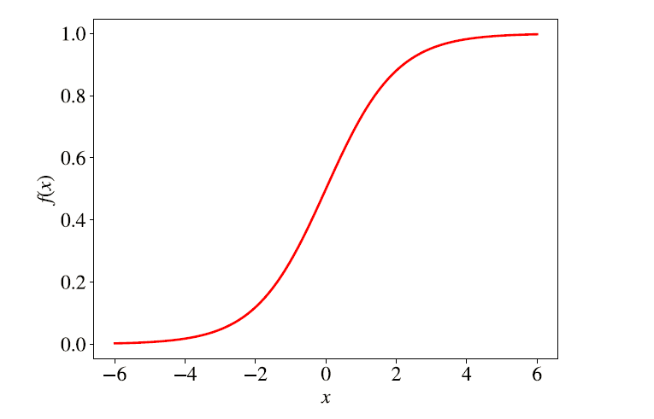
Standard logistic function - Graph
# x is any real number
import numpy as np
print(1.0 / (1 + np.exp(-x)))
Define function:
def sigmoid(x):
return 1.0 / (1 + np.exp(-x))
Ex: x=0, exp(0)= 1 and sigmoid(0)= 0.5

Slide 8
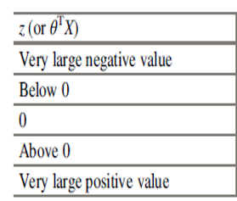
Verify the output of sigmoid function g(z)

Slide 9
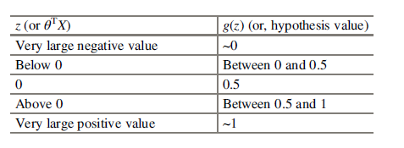
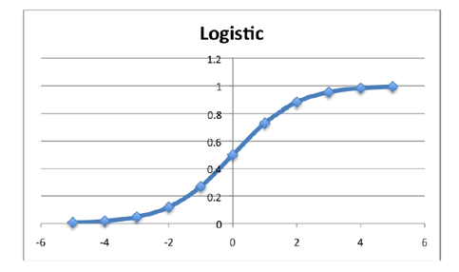
Verify the output of sigmoid function g(z)

Slide 10
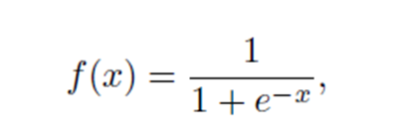
Sigmoid Function
Sigmoid is a mathematical function that takes any real number and maps it to a probability between 0 and 1.
The sigmoid function forms an S shaped graph
that can take any real-valued number and map it into a value between 0 and 1, but never exactly at those limits.
which means as x approaches infinity, the probability becomes 1, and as x approaches negative infinity, the probability becomes 0
The formula of the sigmoid function is:

Slide 11
Logistic Regression
Logistic regression is one of the most popular machine learning algorithms for binary classification.
f(x) = y = output between 0 and 1 (probability estimate)
x = input to the function (our algorithm’s prediction ex: B0+ B1 * x).
Denote x as z to distinguish such that y= 1/(1+e^{–z}) where z= B0+B1*x
e = base of natural log (ln is denoted for base e. Ex: log of base e is log_{e} = ln (natural log))
if the value of x goes to positive infinity then the predicted value of y will become 1
if it goes to negative infinity then the predicted value of y will become 0.
And if the outcome of the sigmoid function is more than 0.5 then we classify that label as class 1 or positive class
if it is less than 0.5 then we can classify it to negative class or label as class 0

Slide 12
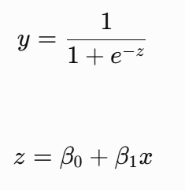
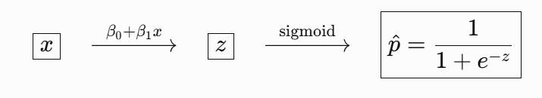
Sigmoid function

Slide 13
How Logistic Regression Predicts Probabilities
Logistic regression models the probability of the default class (e.g. the first class).
Ex: if we are modeling people’s status (Y) as rich(1) or poor(0) from their income(X), then the first class could be rich
The logistic regression model could be written as the probability of rich given a person’s income
Formally: P(income) = P(status = rich|income)
Another way, we are modeling the probability that an input (X) belongs to the default class (Y = 1), we can write this formally as:
P(X) = P(Y = 1|X)
P(y=1∣X) is the probability that the output y is 1 given input X

Slide 14

Logistic Regression Models a Probability
For a binary outcome, Y has two possible classes, commonly represented as 0 and 1.
Example: Predicting status from income
X = Income (predictor variable)
x = a particular observed income value
Y = Status Y=1 → Rich Y=0 → Poor
We choose one outcome as the event of interest. Here, we choose Rich (Y=1).
Logistic regression estimates:P(Y=1∣X=x)
​Meaning: The probability that Y=1 (Rich), given that the person's income is x.
For logistic regression:
The probability of the other outcome is:
Note: We model P(Y=1∣X=x) by convention. Once this probability is known, the probability of Y=0 is automatically 1−p.

Slide 15
Derivation of Sigmoid function
1. Sigmoid function is defined as P(Y = 1|X) = 1/(1+e^(-z))
Sigmoid function is related to the probability
The output of the sigmoid function can be directly interpreted as the estimated probability P(y=1∣x).
Ex: if the sigmoid function outputs 0.8 for a given input, it means that the algorithm estimates an 80% chance that the event y=1 (belonging to a certain class) occurs given the input x
2. Derive 1/(1+e^(-z)) = e^z/(1+e^z))
Note: z is a linear combination of input features and weights used in logistic regression. z= B0+B1*x

Slide 16

Logistic Regression
Logistic regression uses an equation very much like linear regression.
Input values (x) are combined linearly using weights or coefficient values to predict an output value (y).
A key difference from linear regression is that the output value being modeled is a binary values (0 or 1) rather than a numeric value.
Below is an example logistic regression equation:
y is the predicted output,
B0 is the bias or intercept term and
B1 is the coefficient for the single input value (x).
Each column in our input data has an associated B coefficient (a constant real value) that must be learned from our training data.

Slide 17
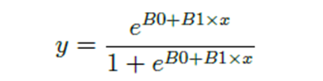

How Logistic Regression Predicts Probabilities
Logistic regression is a classification algorithm
Note that the probability prediction must be transformed into binary values (0 or 1) to make a prediction.
Logistic regression is a linear method, but the predictions are transformed using the logistic function.
The impact of this is that we can no longer understand the predictions as a linear combination of the inputs as we can with linear regression
Continuing on from above, the model can be stated in terms of p(x) rather than y as termed previously

Slide 18

Making Predictions with Logistic Regression
Problem statement: Assume we have a model that can predict whether a person is rich or poor based on their income
Given an income of 150 hundreds is the person rich or poor?
Assume that we have learned the coefficients of B0 = -100 and B1 = 0.6.
We can calculate the probability of rich given an income of 150 hundreds
Formally P(rich | income = 150)
Calculate y
B0=-100, B1= 0.6, x= 150

Slide 19

Making Predictions with Logistic Regression
Problem statement: Assume we have a model that can predict whether a person is rich or poor based on their income
Given an income of 150 hundreds is the person rich or poor?
Assume that we have learned the coefficients of B0 = -100 and B1 = 0.6.
Formally P(rich | income = 150)
Y= 0.000453978687.
So a probability of near zero that the person is rich
prediction = 0 IF p(rich) < 0.5
prediction = 1 IF p(rich) >= 0.5

Slide 20
Derivation of the update equation for logistic regression using stochastic gradient descent

Slide 21
Logistic Regression Model:
The logistic regression model predicts the probability that a given input point belongs to a certain class.
The probability is modeled using the sigmoid function:
sigmoid(z)=1/(1+e^(-z)) ​
z=b0​+b1​⋅x1​+b2​⋅x2​ is the linear combination of the
parameters (b0 b1, b2) and
input features (x1, x2).
In general, Z=w0​+w1 ​x1​+w2 ​x2​+⋯+wk​ xk = WT x

Slide 22
Cost function
Cost Function:
The cost function for logistic regression is the negative log-likelihood (cross-entropy) loss
For a single training example (x1​,x2​,y), the cost can be defined as:

Slide 23

Explanation of the terms
1. Prediction: In logistic regression, the prediction for a given input (x1​,x2​) is the probability that the input belongs to a certain class (usually the positive class). It is computed using the sigmoid function:
Here, b0​, b1​, and b2​ - are the model parameters (coefficients)
x1​, x2 -​ are the input features.
2. True Label (y): The true label y represents the actual class label associated with the input. It's either 0 (negative class) or 1 (positive class) in the context of binary classification.

Slide 24
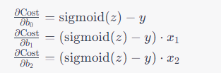
Derivation of the update equations
consider a single training example with input features x1​ and x2​ and a true label y.
The cost function for logistic regression is given by:
Cost(b0​,b1​,b2​)= - y⋅log(prediction)−(1−y)⋅log(1−prediction)
= -y. log(sigmoid(z))-(1-y)*log(1-sigmoid(z))
Taking the partial derivative of the cost function with respect to b0​, b1​, and b2​, we get
Note: for derivation refer to class notes

Slide 25
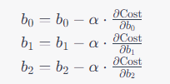
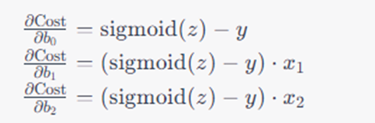
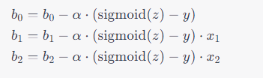
SGD - Derivation of the update equations
Stochastic Gradient Descent Update:
In stochastic gradient descent (SGD), we update the parameters using the negative gradient of the cost function
Substituting the gradient expressions

Slide 26

SGD - Update equations
Stochastic Gradient Descent (SGD)
Instead of computing the gradient over all m examples, SGD updates the coefficients after each training example.
The gradient is computed for a single example (𝑥𝑖,𝑦𝑖) at a time.
SGD Update Equations - for the 𝑖-th training example:
Note: No division by m because we are only using one example.
Loop over each example and update b0​ and 𝑏1​ immediately.

Slide 27
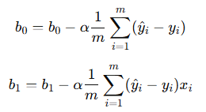
BGD - Update equations
Compute the gradient over all examples, then update 𝑏0 and b1
m = total number of training examples
α = learning rate
Continuing b0, b1, b2…
b0 = b0 - alpha * (1/m) * Σ (^y - y)
b1 = b1 - alpha * (1/m) * Σ (^y - y) *x1
b2 = b2 - alpha * (1/m) * Σ (^y - y) *x2

Slide 28
Logistic Regression by Stochastic Gradient Descent Problem Statement 1- for one Epoch

Slide 29
Training data - Problem Statement 1
x | y
1 | 0
2 | 0
3 | 1
4 | 1

Slide 30
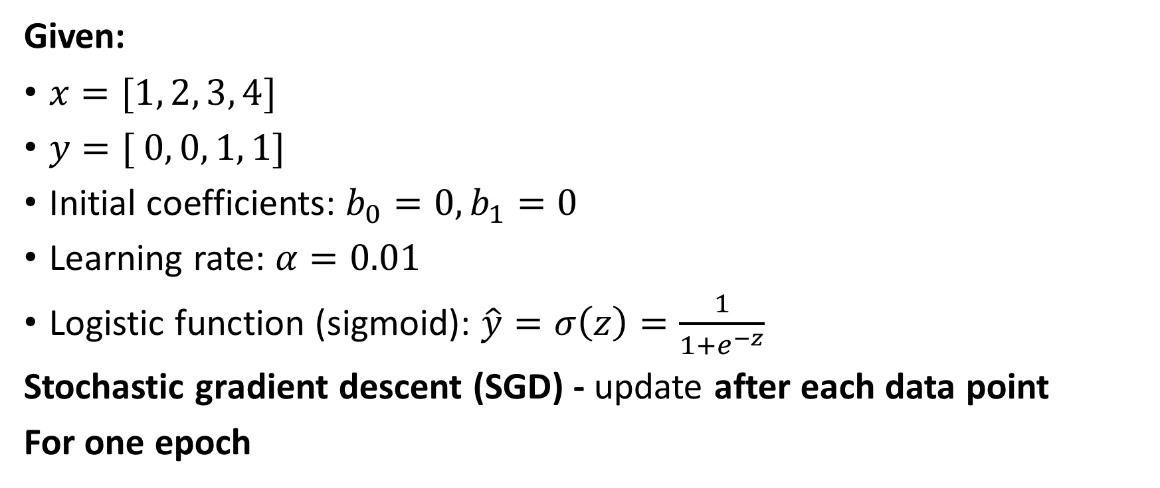
SGD
Given:
$x=[1, 2, 3, 4]$
$y=[ 0, 0, 1, 1]$
Initial coefficients: $b_{0}=0,b_{1}=0$
Learning rate: $α=0.01$
Logistic function (sigmoid): $\hat{y}=σ\left(z\right)=\frac{1}{1+e^{−z}}$
Stochastic gradient descent (SGD) - update after each data point
For one epoch

Slide 31
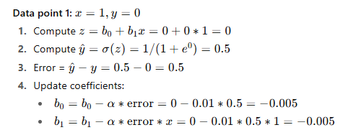
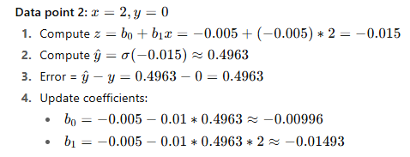
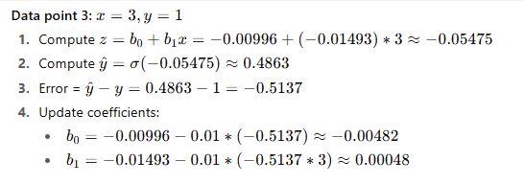
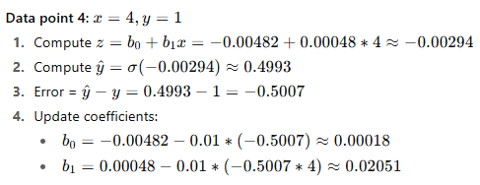
SGD

Slide 32
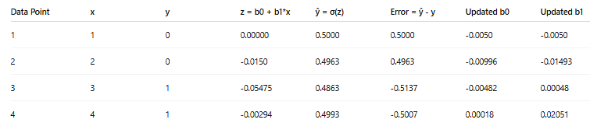
SGD
New coefficients after Epoch 1: $b_{0}≈0.00018, b_{1}≈0.02051$

Slide 33
Loss Computation
For Logistic Regression, the loss is computed using the Binary Cross-Entropy (Log Loss) formula:
At the end of each epoch, we use the updated coefficients to recompute z and y^​=σ(z) for all data points.
We then calculate the loss for each data point and take the average to obtain the loss for that epoch.
Loss for each instance ⟶Average ⟶ Epoch-end Loss

Slide 34
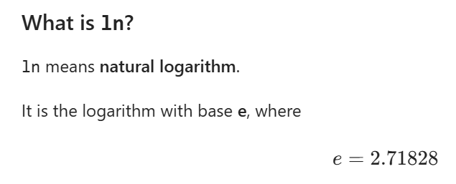
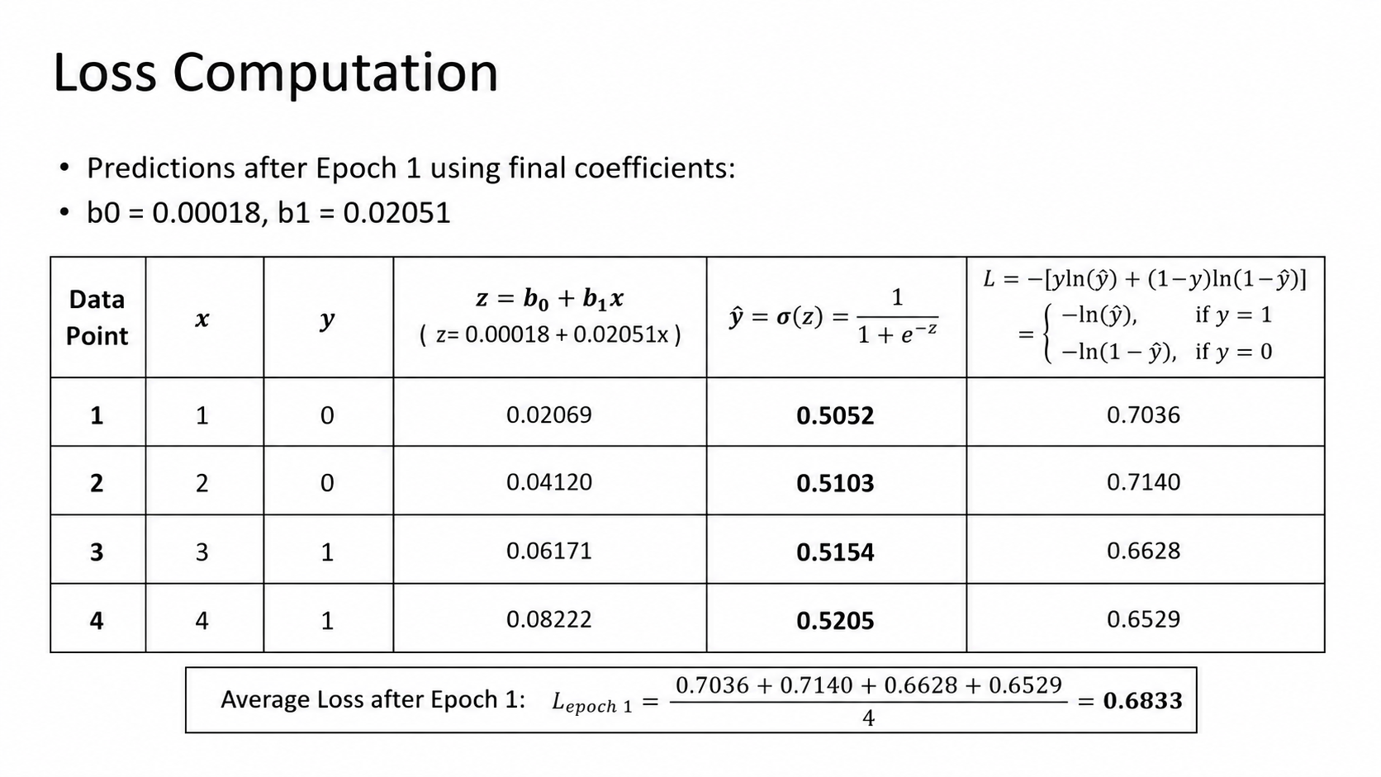

Slide 35
Logistic Regression by Batch Gradient Descent Problem Statement 1 - for four Epochs

Slide 36
SGD vs. BGD
If there are 100 training examples, SGD updates the parameters 100 times per epoch, while BGD updates the parameters 1 time per epoch, .
SGD:
Example 1 ──> UPDATE
Example 2 ──> UPDATE
Example 3 ──> UPDATE
...
Example m ──> UPDATE
BGD:
Example 1 ─┐
Example 2 │
Example 3 ├── calculate gradients ──> UPDATE b0, b1
... │
Example m ─┘

Slide 37
BGD - Update equations
Compute the gradient over all examples, then update 𝑏0 and b1
m = total number of training examples
α = learning rate
Continuing b0, b1, b2…
b0 = b0 - alpha * (1/m) * Σ (^y - y)
b1 = b1 - alpha * (1/m) * Σ (^y - y) *x1
b2 = b2 - alpha * (1/m) * Σ (^y - y) *x2

Slide 38
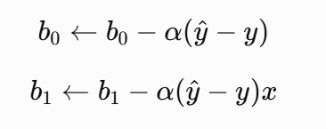
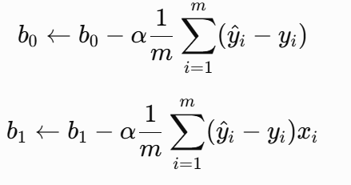
Linear Regression using SGD vs. BGD
Model is y^​=b0​+b1​x
In SGD, b0 and b1 are updated after each individual training example.
BGD: In BGD, b0 and b1 are updated once after processing all training examples (once per epoch).
for epoch in range(num_epochs):
for i in range(m): # loop over each training example
y_hat = b0 + b1 * x[i]
error = y_hat - y[i]
b0 = b0 - alpha * error
b1 = b1 - alpha * error * x[i]
for epoch in range(num_epochs):
sum_error_b0 = 0 # reset at the start of each epoch
sum_error_b1 = 0 # reset at the start of each epoch
for i in range(m): # loop over all training examples
y_hat = b0 + b1 * x[i]
error = y_hat - y[i]
sum_error_b0 += error
sum_error_b1 += error * x[i]
# Update parameters after summing over the batch
b0 = b0 - alpha * (sum_error_b0 / m)
b1 = b1 - alpha * (sum_error_b1 / m)

Slide 39
Logistic Regression using SGD vs BGD
for epoch in range(num_epochs):
for i in range(m):
# Linear combination
z = b0 + b1 * x[i]
# Sigmoid
y_hat = 1 / (1 + np.exp(-z))
# Error
error = y_hat - y[i]
# Update immediately
b0 = b0 - alpha * error
b1 = b1 - alpha * error * x[i]
for epoch in range(num_epochs):
sum_error_b0 = 0
sum_error_b1 = 0
for i in range(m):
# Linear combination
z = b0 + b1 * x[i]
# Sigmoid
y_hat = 1 / (1 + np.exp(-z))
# Error
error = y_hat - y[i]
# Accumulate gradients
sum_error_b0 += error
sum_error_b1 += error * x[i]
# Update after all examples
b0 = b0 - alpha * (sum_error_b0 / m)
b1 = b1 - alpha * (sum_error_b1 / m)

Slide 40
Training data - Problem Statement 1
x | y
1 | 0
2 | 0
3 | 1
4 | 1

Slide 41
Logistic Regression by Batch Gradient Descent
1. Initialize Coefficients: B0= 0, B1=0, alpha=0.01
2. Perform BGD
2.1 Calculate z = B0+B1*x1
2.2 Apply the sigmoid function to get the prediction P(y=1|x)= 1/(1+e^(-z))
2.3 update the coefficients using Batch Gradient Descent Update Equation
b0 = b0 - alpha * (1/m) * Σ (^y - y)
b1 = b1 - alpha * (1/m) * Σ (^y - y) *x

Slide 42
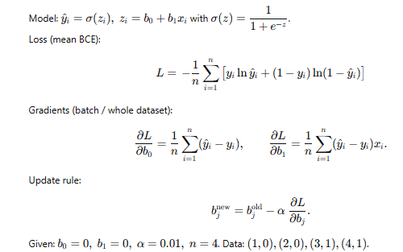
Logistic Regression by Batch Gradient Descent

Slide 43
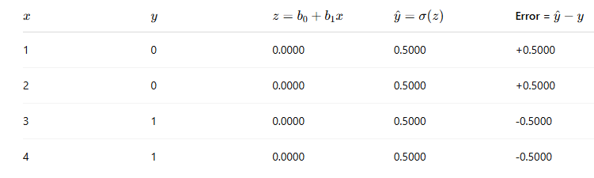
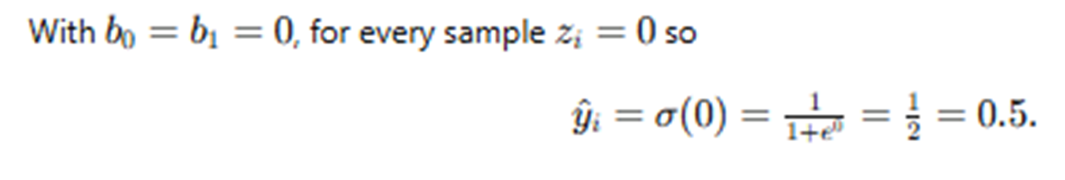
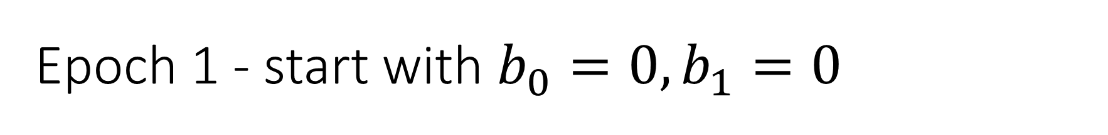
Epoch 1 - start with $b_{0}=0,b_{1}=0$
in SGD the coefficients change after each sample, while in BGD they should remain fixed until the whole batch has been processed

Slide 44
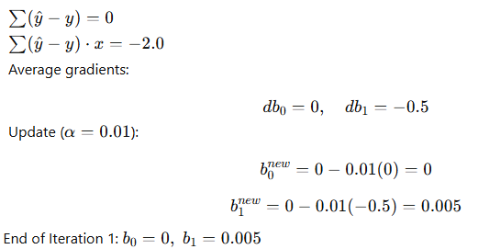
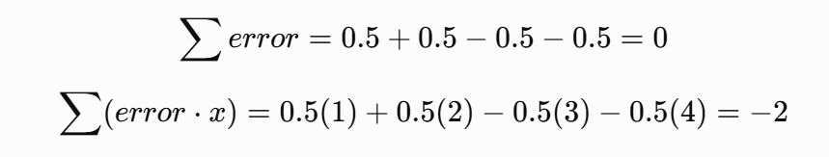

Epoch 1 - start with $b_{0}=0,b_{1}=0$

Slide 45
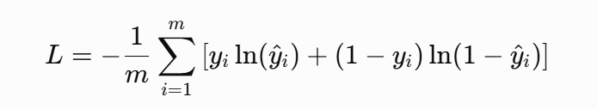
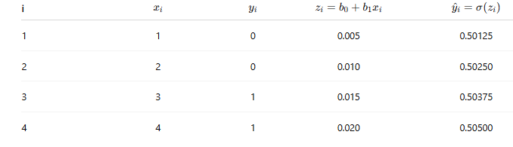

Logistic Regression by Batch Gradient Descent - Epoch 1
Compute the loss after update $b_{0}=0, b_{1}=0.005$
Step 1: Predictions

Slide 46
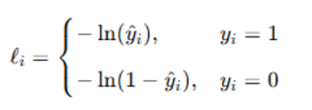
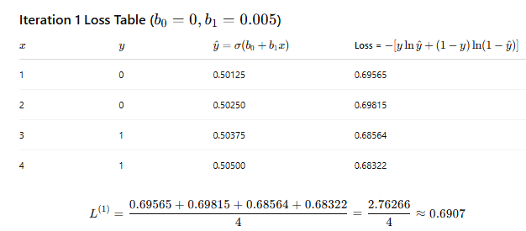
Epoch 1 loss table – Average Loss
Step 2: Compute Loss per sample and Average Loss

Slide 47
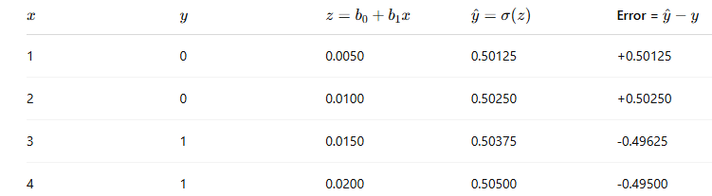


Epoch 2 - start with $b_{0}=0,b_{1}=0.005$
Using parameters from Epoch 1: $b_{0}=0, b_{1}=0.005$

Slide 48
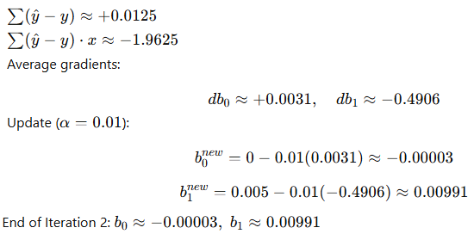

Epoch 2 - start with $b_{0}=0,b_{1}=0.005$
Iteration 2: Using parameters from Iteration 1: $b_{0}=0, b_{1}=0.005$

Slide 49
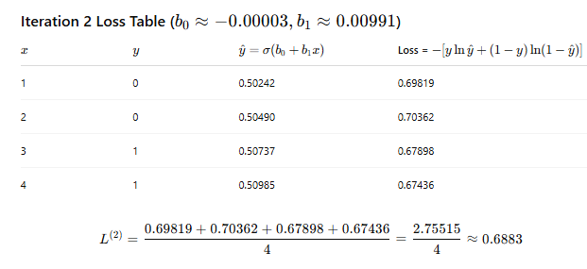
Epoch 2 loss table

Slide 50
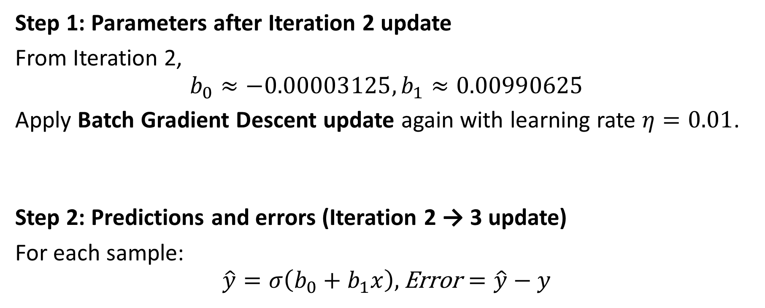
Epoch 3
Step 1: Parameters after Iteration 2 update
From Iteration 2,
$$b_{0}≈−0.00003125, b_{1}≈0.00990625$$
Apply Batch Gradient Descent update again with learning rate $η=0.01$.
Step 2: Predictions and errors (Iteration 2 → 3 update)
For each sample:
$$\hat{y}=σ\left(b_{0}+b_{1}x\right), \text{Error}=\hat{y}−y$$

Slide 51
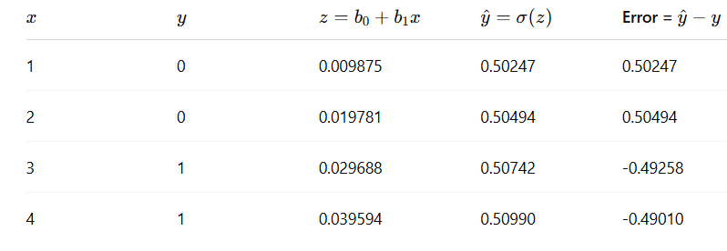
Epoch 3

Slide 52
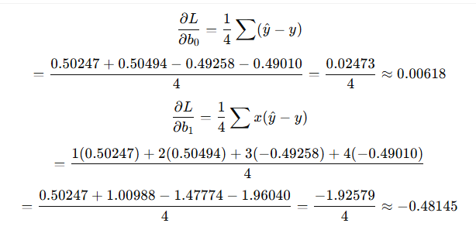
Epoch 3 – Gradient Computation

Slide 53
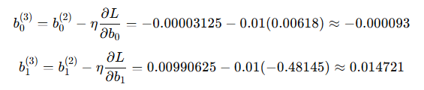
Epoch 3 - Parameter update
After Iteration 3 update: $b_{0}≈−0.000093, b_{1}≈0.014721$

Slide 54
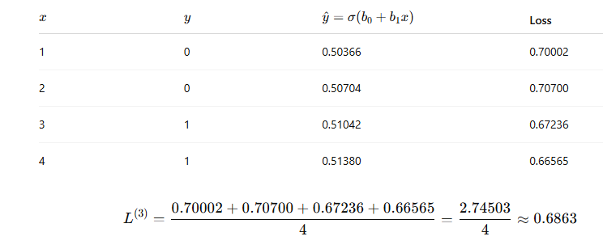
Epoch 3 - Loss computation

Slide 55
List of parameters
Iteration 1 start: 𝑏0=0, 𝑏1=0 → after update →
𝑏0=0, 𝑏1=0.005
Iteration 2 start: 𝑏0=0, 𝑏1=0.005 → after update → 𝑏0≈−0.00003, 𝑏1≈0.00991
Iteration 3 start: 𝑏0≈−0.00003, 𝑏1≈0.00991 → after update → 𝑏0≈−0.000093, 𝑏1≈0.01472
Iteration 4 start: 𝑏0≈−0.000093, 𝑏1≈0.01472

Slide 56
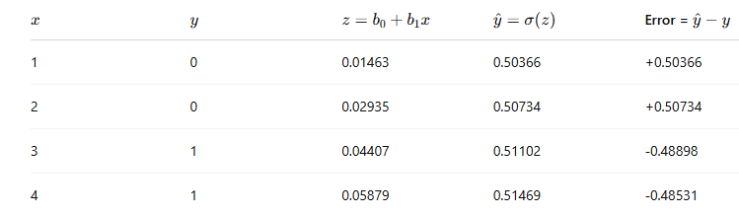

Epoch 4 :start with $b_{0}≈−0.000093, b_{1}≈0.01472$

Slide 57
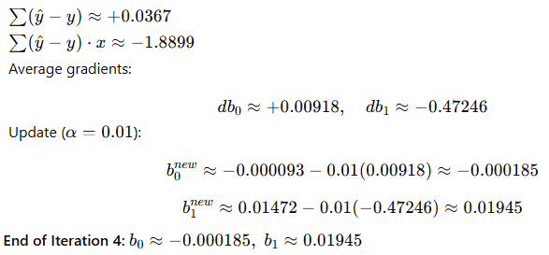
Epoch 4 :start with $b_{0}≈−0.000093, b_{1}≈0.01472$

Slide 58
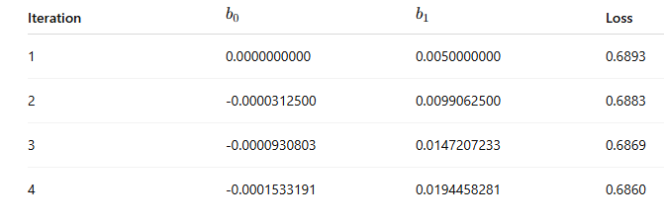
Loss progression

Slide 59
Initial loss for both BGD and SGD - before any parameter update

Slide 60
How to compute the initial loss?
In gradient descent, we often compute the loss at the end of each iteration (i.e., after parameters are updated).
The Epoch 0 loss is not mandatory — it is the initial baseline (before any updates).
We include it to show how much the loss drops immediately after the first update.
To illustrate convergence more clearly, computing Iteration 0 loss with 𝑏0=𝑏1=0 is done

Slide 61
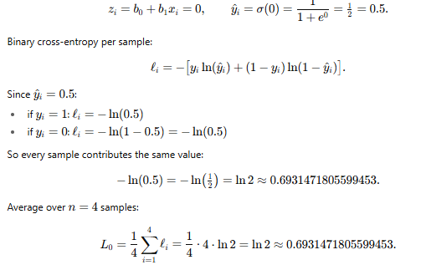

Initial Loss (Before Epoch 1)
Epoch 0 means before any gradient update, using the initial parameters $b_{0}=0, b_{1}=0$
loss is computed once at the very start (t = 0), prior to iteration 1.
Model prediction at $b_{0}=b_{1}=0$: for every sample

Slide 62

Initial Loss (Before Epoch 1)
Initial Loss (Before Any Gradient Update) : At b0​=0, b1​=0, the initial loss is L(0)=0.693147.
Since no parameter update has occurred yet, this initial loss is the same starting baseline for both BGD and SGD

Slide 63
SGD vs. BGD

Slide 64

Illustration of update frequency in BGD vs. SGD
An Epoch = one complete pass over the entire training dataset
Algorithm | When updates happen | Remarks
Stochastic Gradient Descent (SGD) | After each individual sample | Coefficients updated immediately for each data point; noisy but faster updates
Batch Gradient Descent (BGD) | After processing all samples in the dataset (i.e., at the end of the epoch) | Gradients are summed/averaged over all data points; coefficients updated once per epoch
Note: In BGD, gradients are averaged over all m training samples before updating the coefficients.

Slide 65
Illustration of epoch in BGD vs. SGD
1. Epoch = one complete pass over the entire training dataset.
Ex: If we have 4 samples, after seeing all 4 samples once, 1 epoch is completed.
2. Parameter Updates
SGD: The model parameters are updated after each individual sample. With 4 samples → 4 parameter updates per epoch.
BGD: The model parameters are updated after processing the entire dataset. With 4 samples → 1 parameter update per epoch.

Slide 66
Parameter Updates per Epoch in BGD vs. SGD
Algorithm | Parameter updates per epoch | Reason
SGD | m (number of samples) | Update after each sample
BGD | 1 | Update once after full dataset
Mini-batch GD | ⌈m/ batch size​⌉ | Update after each mini-batch
m is the number of training samples.
The ceiling is important for mini-batch GD.
Ex: with m=10 and batch size =4, we have 3 batches of 4,4,2 size, so ⌈10/4​⌉=3

Slide 67
Summary: SGD vs. BGD
Suppose the dataset has 4 samples
Epoch 1
SGD:
Sample 1 → update b0​,b1​
Sample 2 → update b0​,b1​
Sample 3 → update b0​,b1​
Sample 4 → update b0​,b1​
BGD:
Compute gradients for all 4 samples.
Average the gradients → update b0​,b1​ once.
After this, both have completed 1 epoch.
But the number of parameter updates differs: BGD = 1, SGD = 4.

Slide 68
Logistic Regression by Stochastic Gradient Descent with two input variables - Problem Statement 2

Slide 69
Training data - Problem Statement 2
x1 | x2 | y
2 | 1 | 1
3 | 2 | 1
4 | 3 | 0
5 | 4 | 0

Slide 70
Logistic Regression by Stochastic Gradient Descent
Get the final value of B0, B1 and B2 after one (specified number of epochs) epoch
Now that we have trained the model, we can use it to make predictions.
Using coefficients, get the updated prediction by applying sigmoid function
Get the new target label

Slide 71
Logistic Regression by Stochastic Gradient Descent
Repeat the Process
repeat this process and update the model for each training instance in the dataset.
A single iteration through the training dataset is called an epoch.
It is common to repeat the stochastic gradient descent procedure for a fixed number of epochs.
At the end of epoch, calculate error values for the model.
Because this is a classification problem, we need to get an idea of how accurate the model is at each iteration.
Plot the graph of accuracy of the model over specified epochs
Plot epoch (x axis) vs accuracy (y axis)

Slide 72
Logistic Regression by Stochastic Gradient Descent
Compute accuracy
prediction = IF (output < 0.5) Then 0 Else 1
With this simple procedure we can convert all of the outputs to class values (or target labels):
Finally, we can calculate the accuracy for the model on the training dataset:
Accuracy = (Correct predictions/Total predictions) * 100
Total predictions = number of training instances = 4
For the training data, calculate accuracy

Slide 73
Problem Statement 3

Slide 74

Training dataset - Problem Statement 3
This dataset has two input variables (X1 and X2) one output variable (Y).
The input variables are real-valued random numbers drawn from a Gaussian distribution
The output variable has two values, making the problem a binary classification problem
Plot the graph of X1 (x- axis) vs X2 (y axis)

Slide 75

Logistic Regression Dataset – X1 vs X2
How do you analyse the graph?

Slide 76
Logistic Regression
We can easily draw a line to separate the classes
For this dataset, the logistic regression has three coefficients just like linear regression
output = B0 + B1 * X1 + B2 * X2
The job of the learning algorithm will be to discover the best values for the coefficients (B0, B1 and B2) based on the training data.

Slide 77

Logistic Regression by Stochastic Gradient Descent
We can estimate the values of the coefficients for the logistic regression model using stochastic gradient descent
Calculate Prediction
Assign 0.0 to each coefficient and calculating the probability of the first training instance that belongs to class 0.
B0 = 0.0
B1 = 0.0
B2 = 0.0
The first training instance is: X1 = 2.7810836, X2 = 2.550537003, Y = 0.
Using the above equation, calculate a prediction:

Slide 78

Logistic Regression by Stochastic Gradient Descent
calculate a prediction

Slide 79
Logistic Regression by Stochastic Gradient Descent
Update Equation for B0, B1 and B2
update the coefficients using Gradient Descent Update Equation
b0 = b0 - alpha * (1/m) * Σ (^y - y)
b1 = b1 - alpha * (1/m) * Σ (^y - y) *x1
b1 = b1 - alpha * (1/m) * Σ (^y - y) *x2
Note: x is the input value for the coefficient.
B0 does not have an input.
This coefficient is called the bias or the intercept and we can assume B0 always has an input value of 1.0.

Slide 80

Problem Statement 4
Example: Predicting whether a student will pass or fail an exam based on their hours of study
Predict the probability that a student will pass the exam if they study for 3.5/7.5 hours.

Slide 81
Applying stochastic gradient descent to the problem of finding the coefficients for the logistic regression model
Given each training instance:
Calculate a prediction using the current values of the coefficients.
Calculate new coefficient values based on the error in the prediction.
The process is repeated until the model is accurate enough (e.g. error drops to some desirable level) or for a fixed number iterations

Slide 82
Logistic Regression by Stochastic Gradient Descent
Repeat the stochastic gradient descent procedure for 10 epochs.
At the end of epoch calculate error values for the model.
Because this is a classification problem, get accuracy of the model at each iteration.
Plot the graph to show accuracy of the model over 10 epochs.

Slide 83

Logistic Regression with Gradient Descent - Accuracy versus Iteration

Slide 84
Odds and log odds
In probability, odds represent the ratio of the probability of success (an event occurring) to the probability of failure (the event not occurring).
If P is the probability of success and Q is the probability of failure (Q=1−P), then the odds O =P/Q= P/(1-P)
The value of Odds range from zero to infinity and the value of probability lies between zero and one.
Ex: For example, if the probability of winning a game is 0.6, then the odds of winning = 0.6/0.4=0.6/0.4=1.5.
Log odds, often referred to as logit, is the natural logarithm of the odds. Mathematically, it is represented as
logit(P)= ln(O)= ln(P/Q​)
Find the range of Odds and logit

Slide 85
Range: Probability vs. Odds vs. Logit
Range:
Probability 𝑃: 0 ≤𝑃 ≤1
Odds 𝑂: 0≤ 𝑂 <∞
logit range is: −∞<Logit (𝑃)<+∞
Range of Probability and Odds:
When P=0, O=0.
As P approaches 1, O approaches ∞.
Note: Odds never equal ∞; at P=1, O=1/0, which is undefined.
So write Odds 𝑂: 0≤ 𝑂 <∞
Relationship between Probability, Odds, and Logit:
If P approaches 0, then O approaches 0, so logit(P)→−∞
If P=0.5, then O=1, so logit(P)=0​
If P approaches 1, then O→∞, so logit(P)→+∞
odds O = P/(1-P)
logit(P)=ln(O)=ln(P/(1-P​))
we say "log of the odds", but "logit of the probability”.
The logit is the logarithm of the odds.

Slide 86
Odds and log odds - Background
Why are odds transformed into log-odds?
Probability P is restricted to: 0≤P≤1
A linear model can produce values outside this range, so directly modeling probability with a straight line is problematic.
Odds O=P/(1−P)​ range from: 0≤O<∞
This range is one-sided and not suitable for an unrestricted linear predictor.
log-odds (logit): Taking the logarithm of the odds gives the log-odds (logit):
logit(P)=ln(O)=ln(P/(1−P)​ )
The logit can take any real value: −∞<logit(P)<+∞​
Therefore, logistic regression can model the log-odds as a linear function of the predictors: logit(P)=b0​+b1​x​

Slide 87




Odds and log odds
P(x) is the predicted probability that the event y=1 occurs for a given input x. It is the output of the sigmoid function.
The odds are:
The log of the odds is called the logit:
Logistic regression models this as:

Slide 88

Probability vs. Odds and Probability vs. Logit
At 𝑃=0.5, logit(P) = 0.
As 𝑃→0, logit(P) → −∞
As 𝑃→1, logit(P)→ +∞
Left plot: As P increases from 0 toward 1, odds increase from 0 toward ∞
Right plot: The logit transforms probabilities 0<P<1 onto the entire real line (−∞,+∞).

Slide 89

Odds and log odds - Summary

Slide 90
Problem Statement
A binary logistic regression model has b0=-2 and coefficient b1=1, for an observation with x=3:
Using the odds interpretation of logistic regression, determine (P(y=1)), the predicted probability that the observation belongs to class 1. Do not use the sigmoid function. Show the intermediate steps in your calculation.
Determine (P(y=1)) by applying the sigmoid function directly.
Compare the probabilities obtained using the two approaches and explain the relationship between them.

Slide 91
Simplify log odds expression
Deriving the Log-Odds from the Sigmoid Function
We have sigmoid function given by P(x) = e^z/(1+e^z)
1-p(x)= 1/(1+e^z)
ln⁡(P(x)/(1−P(x)​) =ln(e^z) = z
ln⁡(P(x)/(1−P(x)​) = z
Note that Input values (z) are combined linearly using weights or coefficient values to predict an output value (y).
z = B0+B1*x
ln⁡(P(x)/(1−P(x)​) =B0+B1*x
ln(odds) = B0 + B1 * X

Slide 92



Simplify log odds expression – Alternate way
Simplifying ln(P(x)/(1−P(x)​)
In logistic regression, the probability of event 𝑦=1 given input 𝑥 is modeled as: 𝑃(𝑥)=1/1+𝑒^−𝑧,where 𝑧=𝑤𝑇𝑥+𝑏
​ln⁡(P(x)/(1−P(x)​) = (1/ 1+e^-z)/ (1- (1/ 1+e^-z))
Logistic regression is linear in the log-odds of the outcome, while the corresponding probability is a nonlinear function of the input features.

Slide 93
Simplify log odds expression - Verification
Verify that ln⁡(𝑃(𝑥)/1−𝑃(𝑥))=𝑧
Let 𝑧=2
1. Compute 𝑃(𝑥) using sigmoid
P(x)=1/ 1+e−^z = ​ 1/ 1+e−^2=1/1+0.1353​≈0.8808
2. Compute odds 𝑃(𝑥)/1−𝑃(𝑥)=0.8808/1−0.8808 ≈7.389
3. Take natural log: ln⁡(7.389)≈2

Slide 94

Linear regression vs Logistic regression
Linear regression: The output 𝑌=b0+b1x is a straight line. It can take any value. So it is fine for continuous predictions but not valid as a probability.
Logistic Regression: The output is passed through the sigmoid curve, so predictions are always between 0 and 1. That makes it valid for probability modeling

Slide 95

Linear regression vs Logistic regression
Linear regression directly predicts a continuous response Y^
Linear Regression Y^=B0​+B1​X, With B0​=−4, B1=1, X=5:Y^=1
Logistic regression models the log-odds as a linear function of the input and transforms the resulting linear predictor into a probability using the sigmoid function.

Slide 96


How Logistic Regression Predicts Probabilities
The linear combination z=b0+b1x represents the log-odds of the positive class (y=1).
The sigmoid function then transforms z into a probability between 0 and 1. ​

Slide 97

Prepare Data for Logistic Regression
The assumptions made by logistic regression about the distribution of data is much the same as the assumptions made in linear regression.
in predictive modeling we are focused on making accurate predictions
Binary Output Variable: logistic regression is intended for binary (two-class) classification problems.
Logistic regression predicts the probability that an instance belongs to class y=1. The predicted probability can then be converted into a class label (0 or 1) using a classification threshold.
Note: 0.5 is a common threshold, but it is not mandatory; the threshold can be adjusted depending on the application.

Slide 98
Prepare Data for Logistic Regression
Remove Noise: Logistic regression assumes no error in the output variable (y), consider removing outliers and possibly misclassified instances from training data.
Gaussian Distribution: Logistic regression is a linear algorithm (with a nonlinear transform on output).
It does assume a linear relationship between the input variables with the output.
Data transforms of our input variables that better expose this linear relationship can result in a more accurate model.

Slide 99
Prepare Data for Logistic Regression
Remove Correlated Inputs: Like linear regression, the model can overfit if we have multiple highly-correlated inputs.
Consider calculating the pairwise correlations between all inputs and removing highly correlated inputs.
Fail to Converge: It is possible for the expected likelihood estimation process that learns the coefficients to fail to converge.
This can happen if there are many highly correlated inputs in our data or the data is very sparse (e.g. lots of zeros in input data).

